Slide 1
WNR
Stephen Xia
Tingkai Liu
Yuan Gao
Xin Huang

Slide 2
Motivation & Scope
Patients with severe epilepsy untreatable by medicine or therapy have to undergo invasive epilepsy surgery, to localize the source of the epileptic brain activity through intracranial EEG with a resolution greater than what is provided by scalp EEG.
Such data collecting procedures are invasive, expensive, and time-consuming. The current standard is to use a bedside rolling station with a monitor and computer racks that have wires connecting the electrocochleography system directly to the patient’s brain. This confines them to their hospital beds for days on end with barely any interaction or motion, severely limiting their quality of life.
WNR seeks to produce a new ECoG (a.k.a. Intracranial EEG) electrode that incorporates wireless connectivity between each individual intracranial electrode probe and a central terminal. Each electrode will be attached to a low-power wireless control unit that will read and transmit neural data in real-time to a receiver. An array of up to 16 wireless electrodes should be able to transmit simultaneously to a single receiver. From the receiver, medical professionals can access the data in real-time and analyze the captured data to best treat the patient. Our embedded system seeks to untether the patients and give them their mobility and their life back.

Slide 3
Customer Needs
Safety & Regulations
FDA Medical Device & HIPPA Data Privacy Requirements
Do not heat up the surrounding skin by a change of more than 2℃/3.6℉
No leakage current from device into brain
Real-time, accurate, and comprehensive data collection
Wireless Data link with adequate bandwidth and throughput sending to an external device
Sample and send data from all 16 electrodes on 16 probes with sufficient bit resolution
Encrypt and decrypt data with no loss in resolution
Convenience, portability, and long-lasting
Independent usability of each probe without the need to physically network probes in a grid
Compact and lightweight form factor that does not interfere with other probes
Battery should last at least a working day and be easily user-replaceable

Slide 4
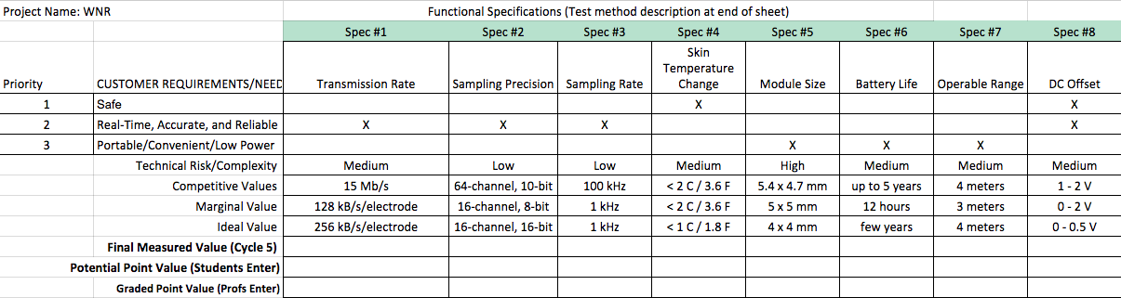
Functional Specifications

Slide 5
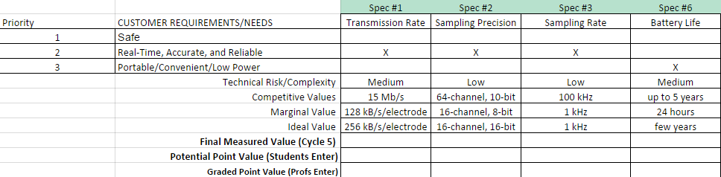
High Priority Specifications

Slide 6
Final Design Specifications
Intan Technologies RHD2132
32-channel amplifier chip A2D
Texas Instruments MSP430F5438A
256KB Flash, 16KB RAM, 12 Bit ADC, 4 USCIs, 32-bit HW Multi
Texas Instruments CC2564 Dual Mode (Classic Basic Rate / Enhanced Data Rate) + Low Energy
Bluetooth v2.1 BR/EDR - Max Throughput 2.1 Mb/s | Max Bandwidth 3 Mb/s
Bluetooth 4.1 BLE - Max Throughput 0.27 Mb/s | Max Bandwidth 1 Mb/s
Application utilizing 16 electrodes x 16 channels x 8 bits x 1000 ksps = 2 Mb/s
Power-One Zinc Air Mercury Free P13 Battery
310mAh @ 1.45V
Stack 2 batteries in series 310mAh @ 2.9V
Ideal packaged form factor of 8mm diameter by 12mm height

Slide 7
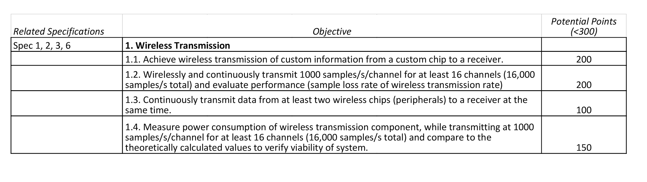
Wireless System

Slide 8
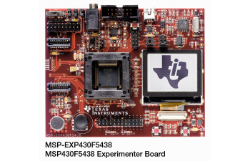
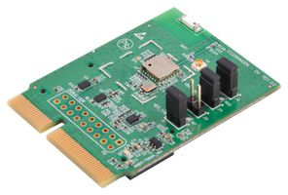
Wireless System
Past Solutions:
BLE: CC2650 and Nordic nRF52 series
Half the semester was spent on the failed BLE
Current System: TI MSP430 F5438 + CC2564 BT module
For the purposes of evaluation:
MSP-FET430UIF
Two android devices as terminal

Slide 9

Wireless System 1.1 - BT Connection
BT System = TI MSP430 F5438 + CC2564 BT module
1 Terminal Device + 1 BT System

Slide 10
Wireless System 1.2 - BT Streaming
BT System = TI MSP430 F5438 + CC2564 BT module
1 Terminal Device + 1 BT System

Slide 11
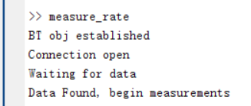
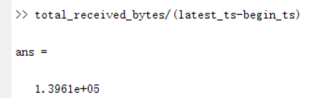
Wireless System 1.2 - BT Streaming
Stream 16000 bytes/s:
Measure datarate = 14,000 bytes/s

Slide 12
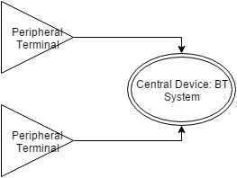
Wireless System 1.3 - BT Multiple Devices
BT System = TI MSP430 F5438 + CC2564 BT module
2 Terminal Device + 1 BT System

Slide 13
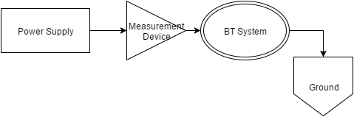
Wireless System 1.4 - Measure Power Consumption
BT System = TI MSP430 F5438 + CC2564 BT module
1 Terminal Device + 1 BT System
Measure power consumption of BT System

Slide 14
Wireless System 1.4 - Measure Power Consumption
Maximum Readings transmitting 160 bytes/10ms (16000 bytes/s):
V = 0.78 V
I = 10 mA
Requires 240 mAh to run for 24 hours

Slide 15
Analog Front End
Key component
System setup
Prototype functionality
Power Consumption
Safety Precautions

Slide 16
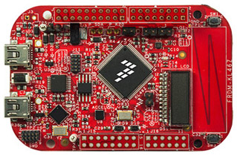
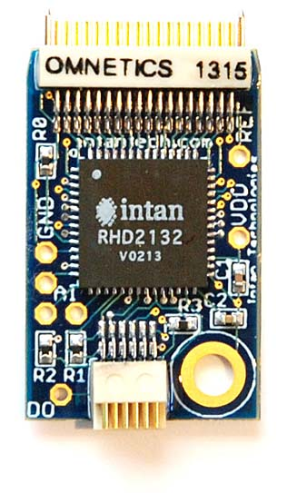
AFE Prototyping Components
Freedom KL46z with ARM-Cortex M0+
Main uController
Talking to chip
32-Channel Intan Chip
Main bank-breaker
Responding with conversion results
Laptop
MATLAB used to process data

Slide 17
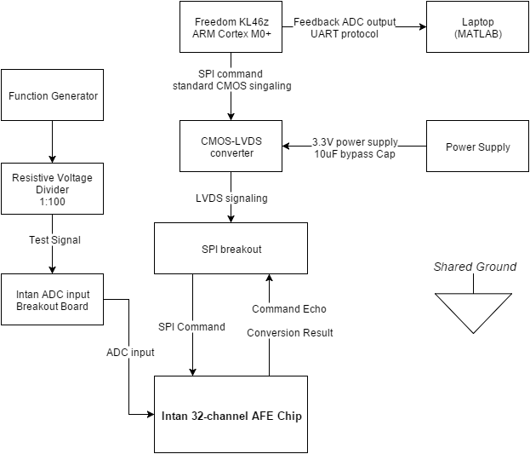
AFE System Diagram

Slide 18
AFE Prototype Functionality
Verify SPI connection fidelity
Read register 40-44 which contains INTAN in ASCII
Program Chip with the following specifications and read back results:
ADC buffer bias = 32 (<= 120 kS/s)
MUX bias = 40 (<= 120 kS/s)
ADC output format = 2's complement
Amp High cutoff = 500 Hz
Amp Low cutoff = 0.1 Hz
Amp power selection = all 32 channels
Convert test signals and display results on computer**
Hard to generate mV signal with little noise

Slide 19
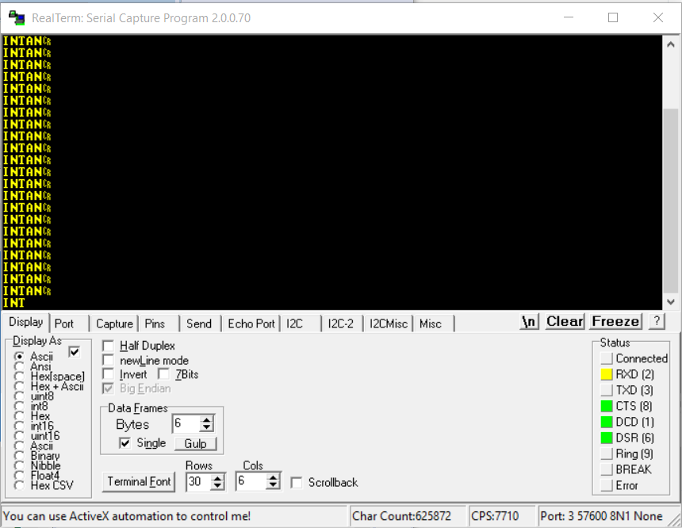
Functionality - Verify SPI connection fidelity
Read Reigster
40 -> I
41 -> N
42 ->T
43 ->A
44 ->N

Slide 20
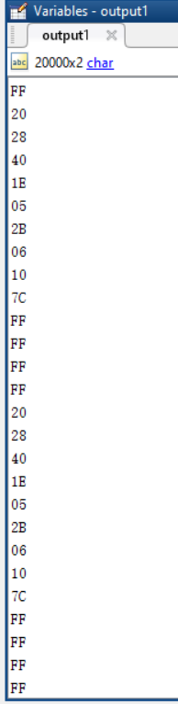
AFE Functionality - Program Chip with the following specifications
ADC buffer bias = 32 (<= 120 kS/s)
MUX bias = 40 (<= 12 kS/s)
ADC output format = 2's complement
Amp High cutoff = 500 Hz
RH1_DAC1 = 30
* RH1_DAC2 = 5
* RH2_DAC1 = 43
* RH2_DAC2 = 6
Amp Low cutoff = 0.1 Hz
RL_DAC1 = 16
RL_DAC2 = 60
RL_DAC3 = 1
Amp power selection = all 32 channels
Register Value Outputs:
1 -> 0x20
2 -> 0x28
4 -> 0x40
8 -> 0x1E
9 -> 0x05
10 -> 0x2B
11 -> 0x06
12 -> 0x10
13 -> 0x7C
14 -> 0xFF
15 -> 0xFF
16 -> 0xFF
17 -> 0xFF

Slide 21
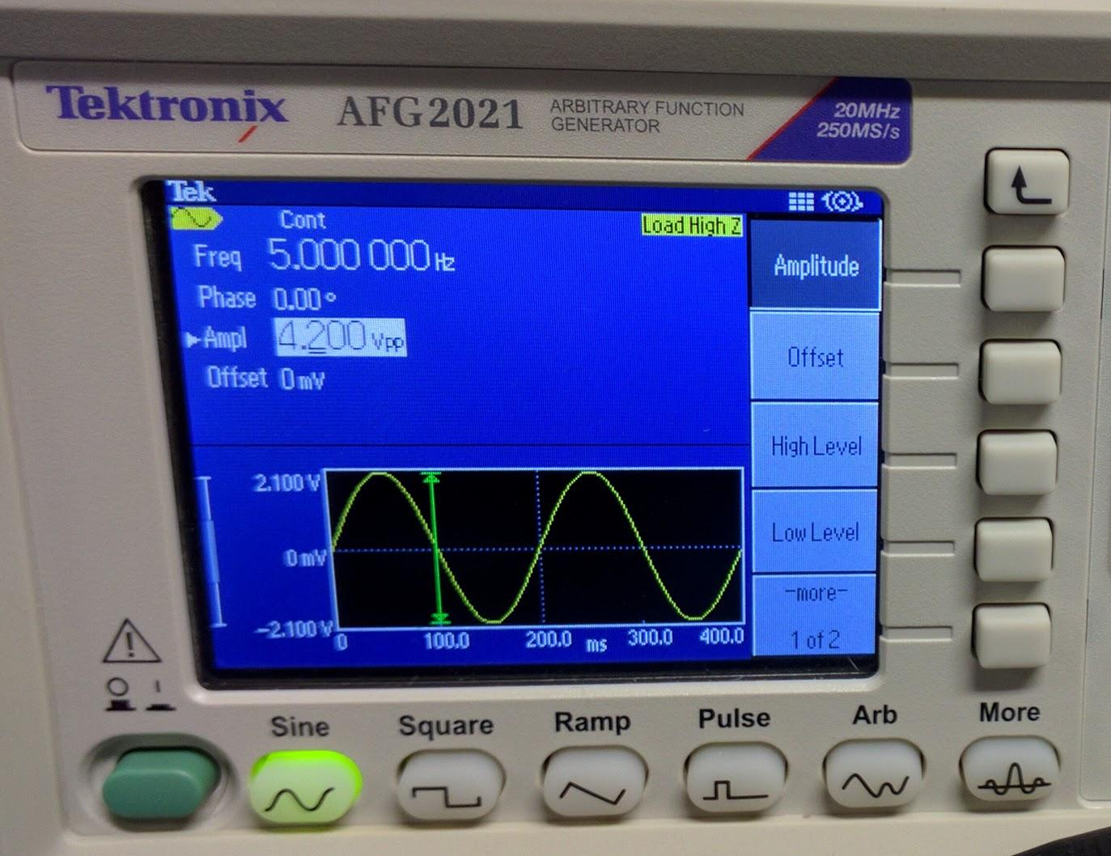
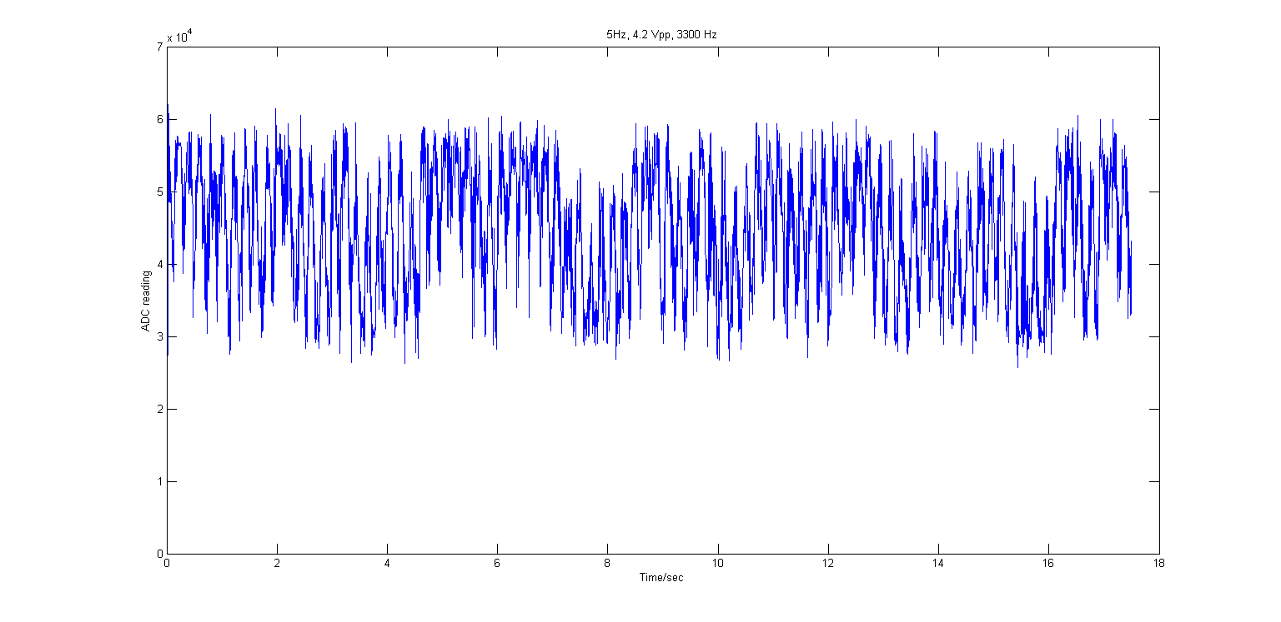
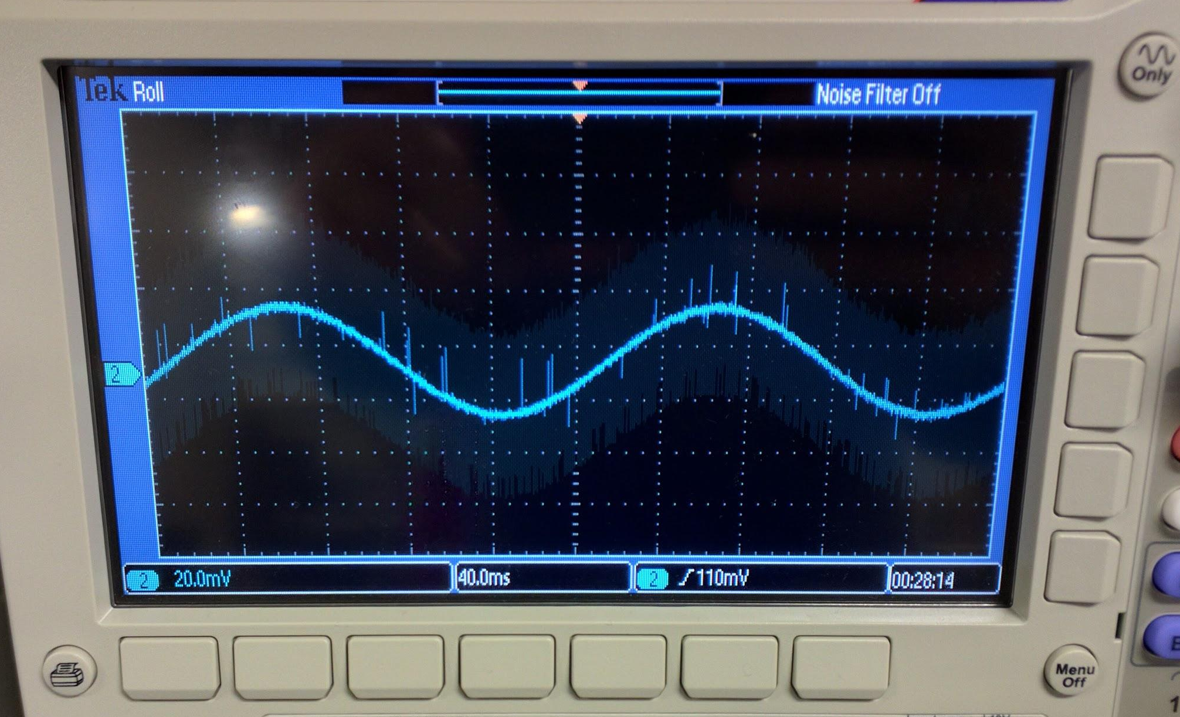
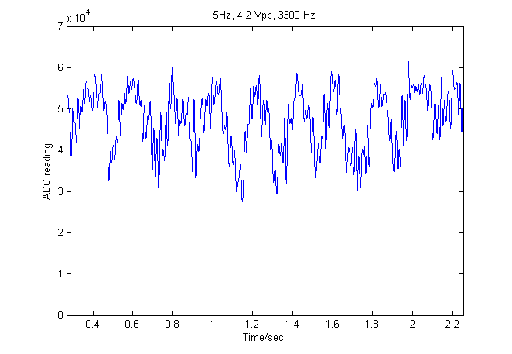
AFE Functionality - Convert test signals and display
NOISE

Slide 22
AFE Power Consumption
Baseline amplifier array current: 200 µA
Amplifiers: 32 × 7.6 µA/kHz × 1 kHz = 243 µA
Baseline ADC current: 510 µA ADC/MUX: 2.14 µA/(kS/s) × 70 kS/s = 150 µA
LVDS I/O - 5.4mA
LVDS conversion chip = 8 mA
Total supply current: 14 mA

Slide 23
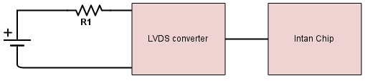
AFE Power Consumption
I = 22.5 mA -> 22.5 mAh
V = 3.07 V
P = I*V = 0.07675 W
22.5mAh -> 540 mAh for 24 hr

Slide 24
AFE Safety Precautions
Intan Chip
ESD safety
ADC input limit
built in protective circuits with diodes
+/- 400mV from GND
Solution:
ESD mat
Voltage Divider to limit input voltage

Slide 25
COMPRESSION ALGORITHMS
Since the requirement of sampling rate and wireless transmission capacity are in conflict, we need to think out of box--with the power of compression, the data rate can be reduced by as high as 4x.
The compression algorithm targets to encode raw binary data, and does not use extra encoding scheme to save on-disk storage.

Slide 26
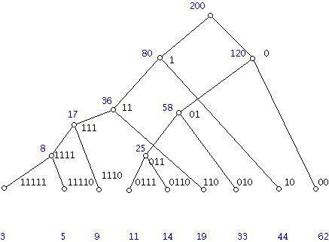
COMPRESSION ALGORITHMS
Huffman Code

Slide 27
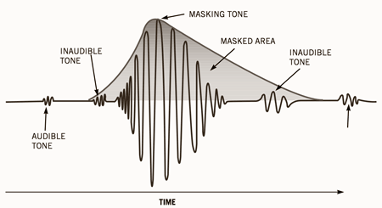
COMPRESSION ALGORITHMS
Audio Compression Algorithms
MP3/MP4

Slide 28
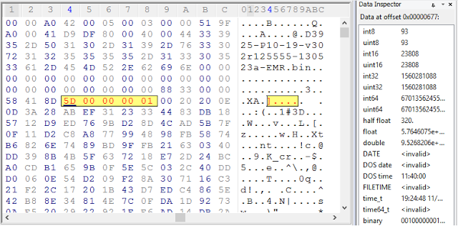
COMPRESSION ALGORITHMS
Lempel-Ziv-Markov Chain (LZMA)

Slide 29
COMPRESSION ALGORITHMS
Other algorithms:
ALZ77, AZTEC, TP, CORTES, Dual KLT…
All have great performance, some even reaches 12.0 compression ratio.
Restriction: cannot adopt over-complicated algorithms; should only take a few lines of code

Slide 30
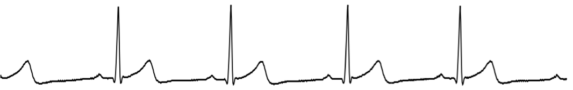
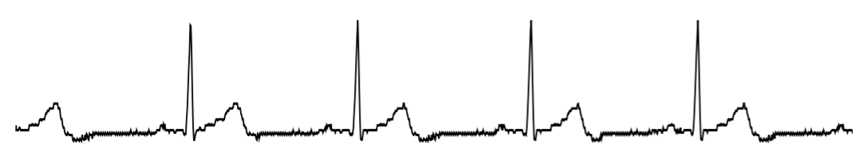
ALZ77 Method
Matching Tolerance | Comp. Ratio | Sampling Rate | RMS Diff. (%)
0 | 3.2 | 250 * 8b | 0
1 | 12.9 | 250 * 8b | 0.3
2 | 22.5 | 250 * 8b | 0.8
3 | 31.4 | 250 * 8b | 1.6

Slide 31
COMPRESSION RESULTS
 | Code Size | Lossy | Speed | Comp. Ratio (140KB) | Comp. Ratio (5MB) | Feasibility (Power cons.)
Huffman | 27KB | N | Fast | 2.45 | 1.064 | ✔
MP3 | > 1MB | Y | Medium | - | - | X
LZMA | 73KB | N | Adjustable | 4.375 | 4.545 | ✔

Slide 32
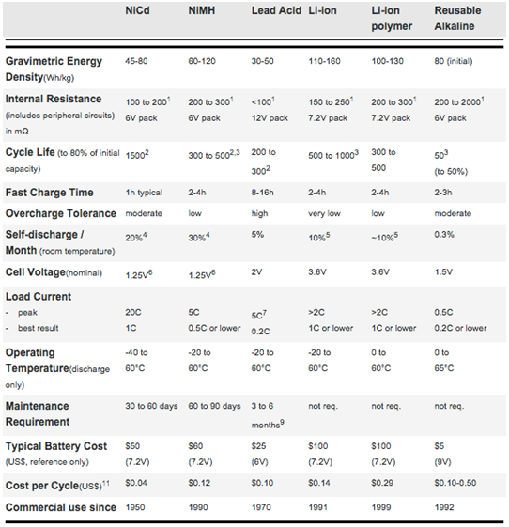
Standard Battery Technologies

Slide 33
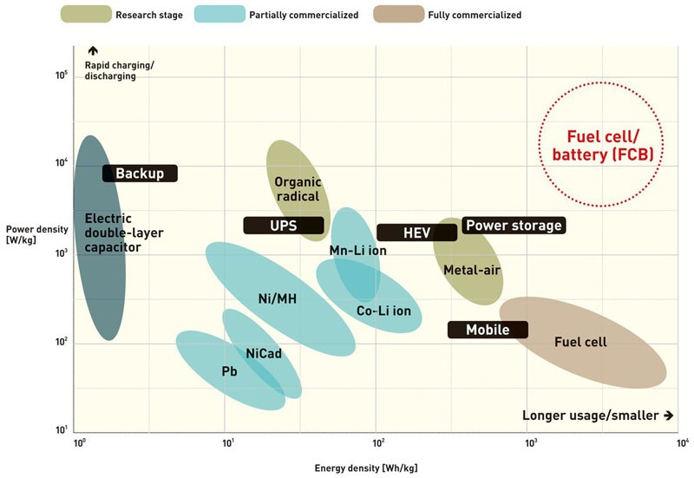
Energy Density Comparison

Slide 34
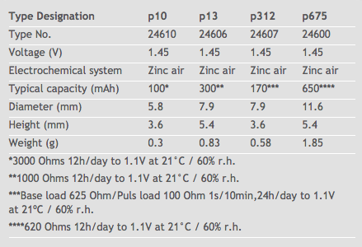
The Chosen (Power) One P13
Why zinc air technology?
Zinc air batteries have an especially high energy density and exhibit an almost flat drain curve.
In an “inactive state” with protective tab attached self-drain amounts to a mere 3% a year. After the tab is removed and several seconds of activation time, the battery begins to produce current. Zinc air batteries can only be stored for a limited period and should be used as quickly as possible.

Slide 35


